Slide 1


Google Machine Learning courses
Notes:
https://developers.google.com/machine-learning/crash-course

Slide 2
What you will learn
Linear Regression
Logistic Regression
Classification
Working with Numerical Data
Working with Categorical Data
Datasets, Generalization, and Overfitting
Neural Networks
Embeddings
Large Language Models
Production ML Systems
AutoML
ML Fairness

Slide 3
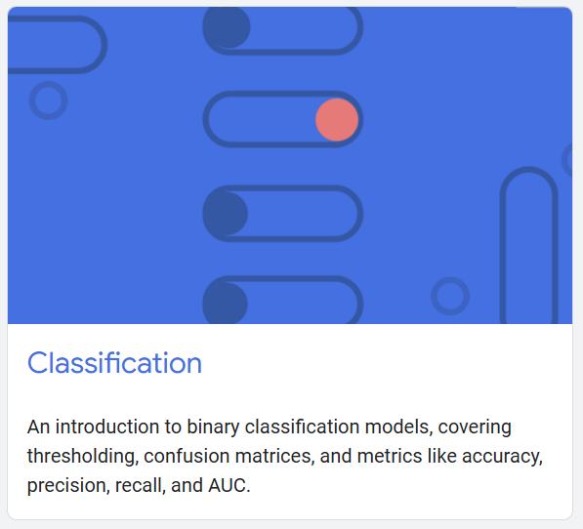
Classification
Notes:
https://developers.google.com/machine-learning/crash-course/classification

Slide 4
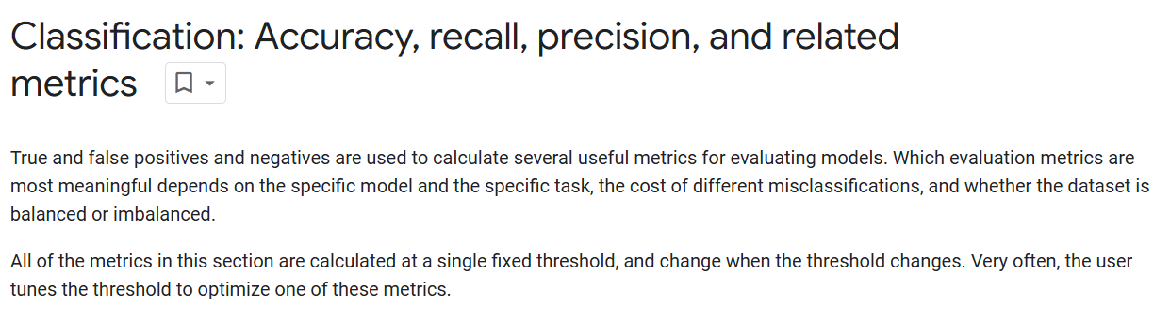

Slide 5
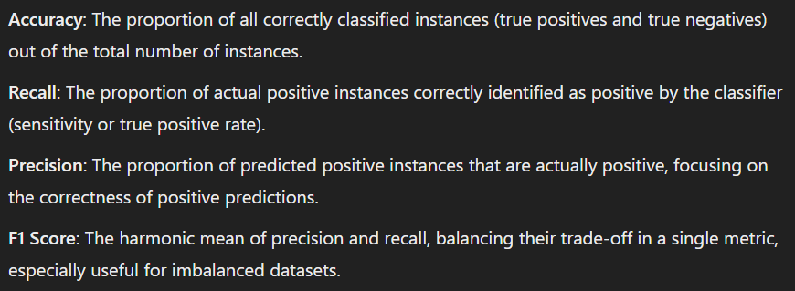

Slide 6


Slide 7
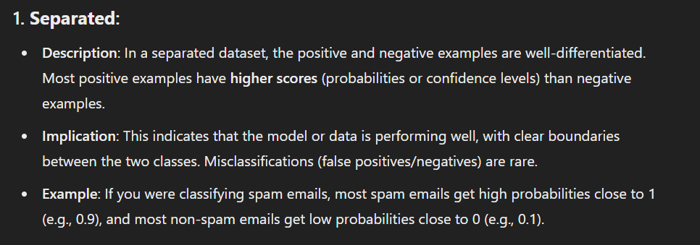
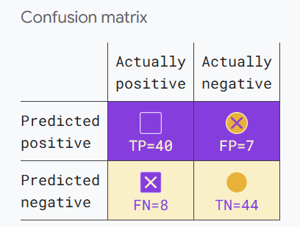

Slide 8
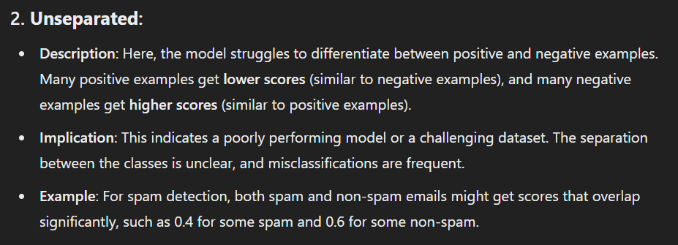
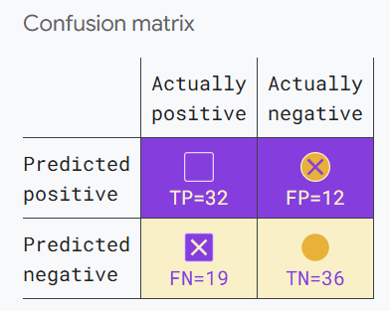

Slide 9
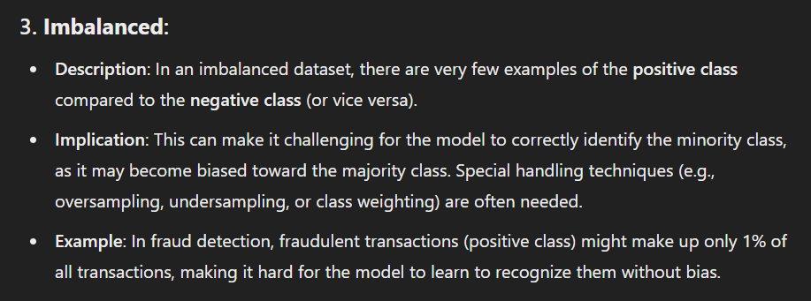
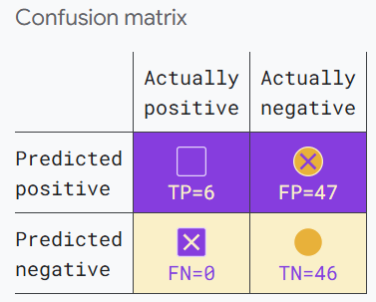

Slide 11
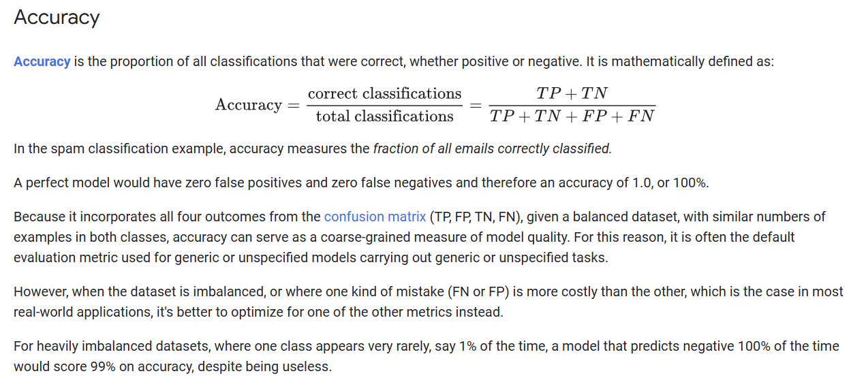

Slide 12
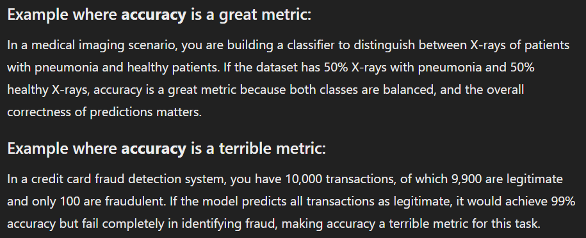

Slide 13
Accuracy: 0.85
Accuracy: 0.69
Accuracy: 0.53

Slide 14
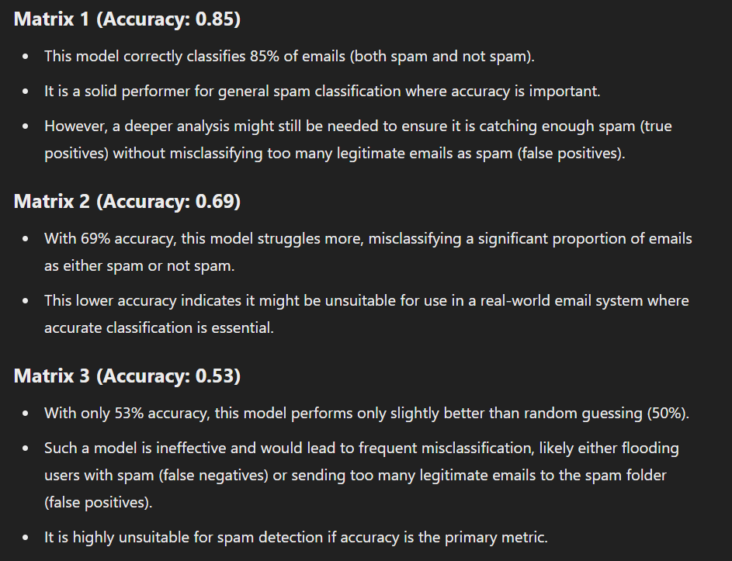

Slide 15
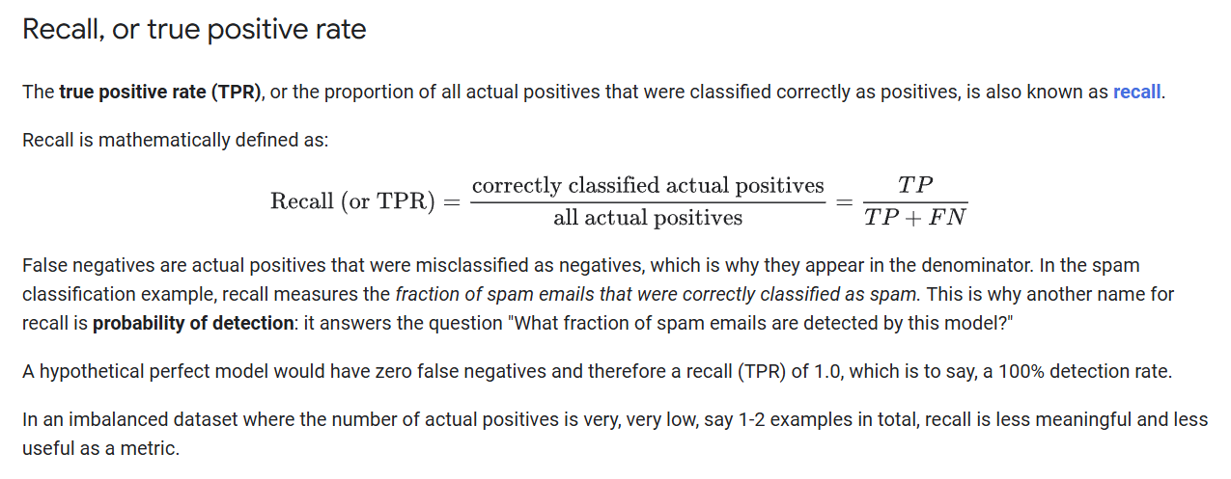

Slide 16
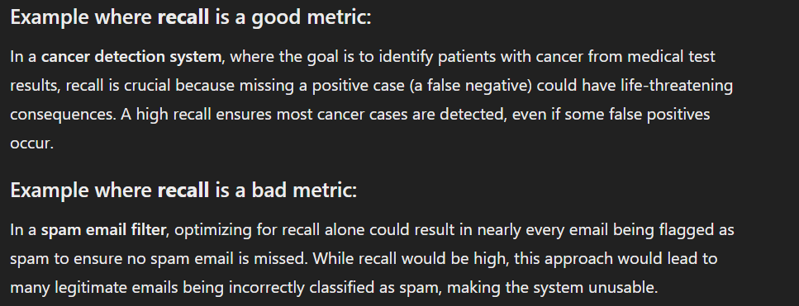

Slide 17
Accuracy: 0.85
Recall: 0.83
Accuracy: 0.69
Recall: 0.63
Accuracy: 0.53
Recall: 1.0

Slide 18
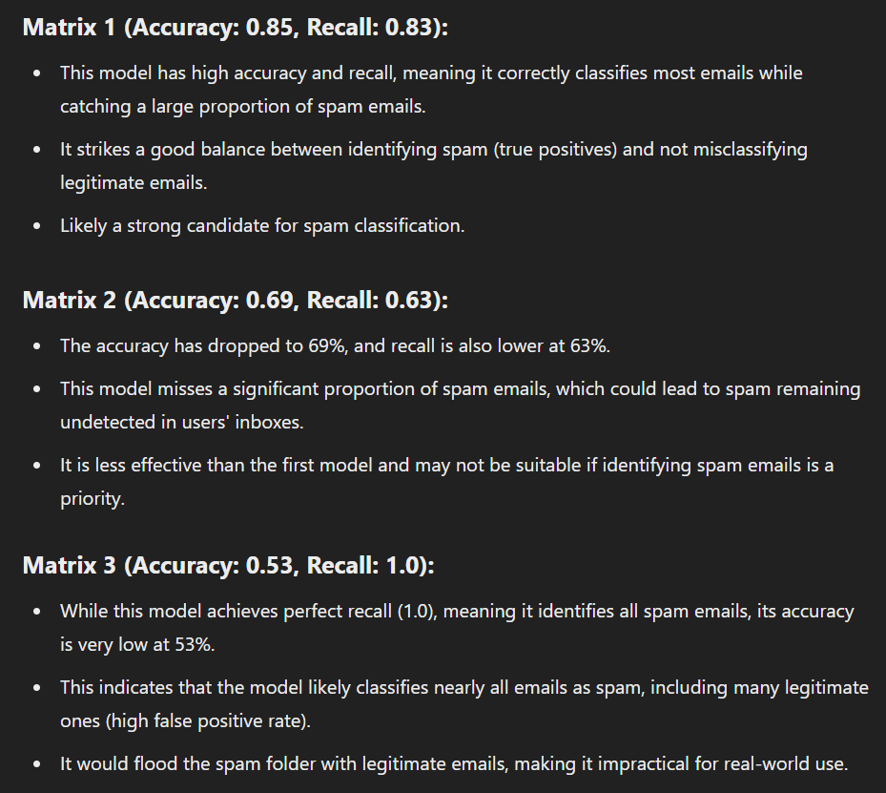

Slide 19
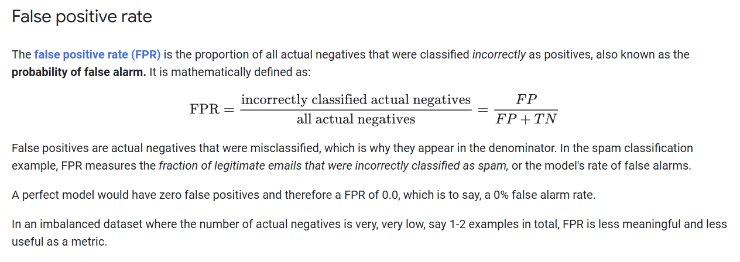

Slide 20
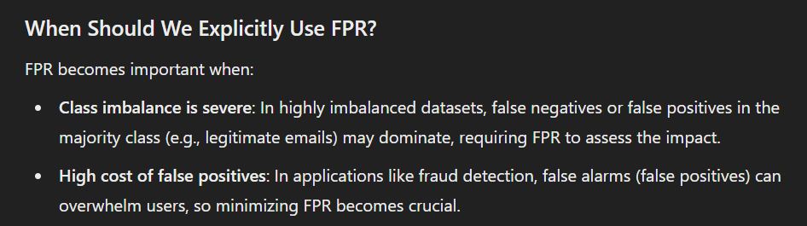

Slide 21
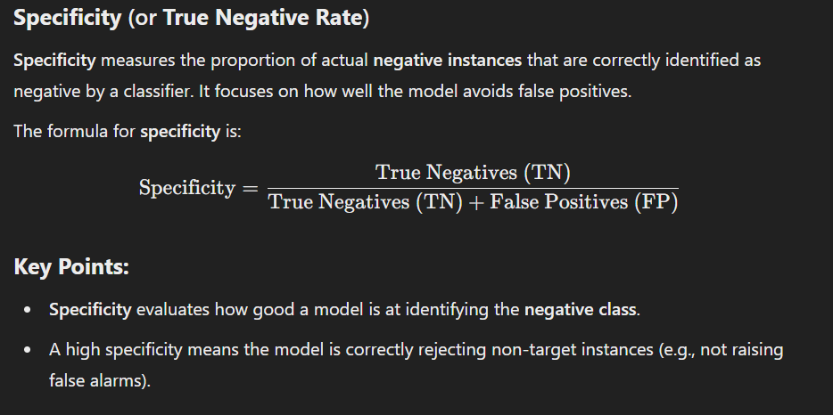

Slide 22
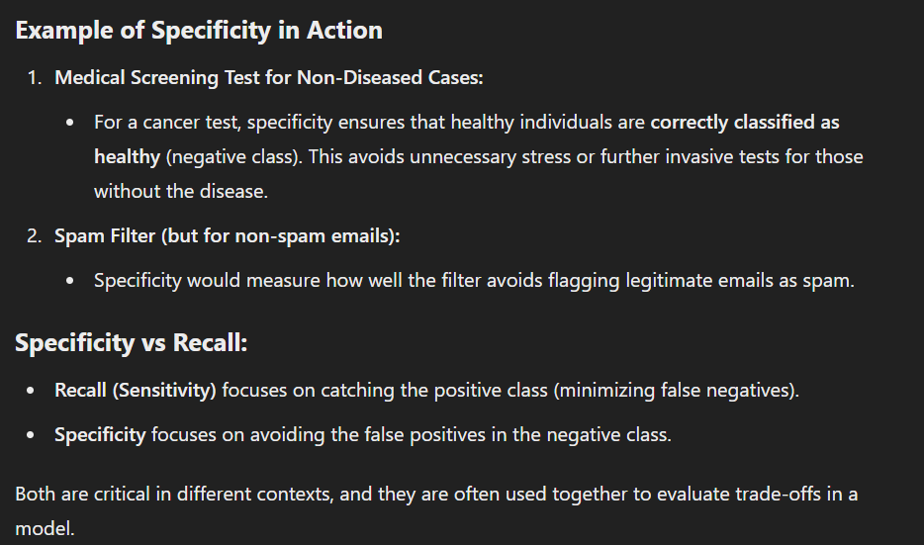

Slide 23




Notes:
https://www.youtube.com/channel/UC35ZpwldGw7ZJ5R-2sLijzw

Slide 24
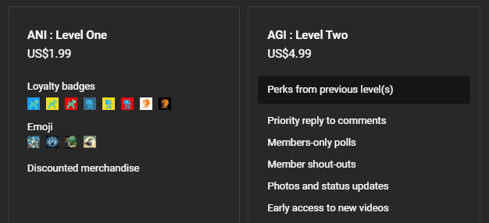

Membership has its privileges
Notes:
https://www.youtube.com/channel/UC35ZpwldGw7ZJ5R-2sLijzw/join

Slide 25

https://www.youtube.com/@AINewsFresh

Slide 26

https://www.youtube.com/@DailyAINewsPodcast

Slide 27

https://www.youtube.com/@AIPapersPodcastDaily

Slide 28
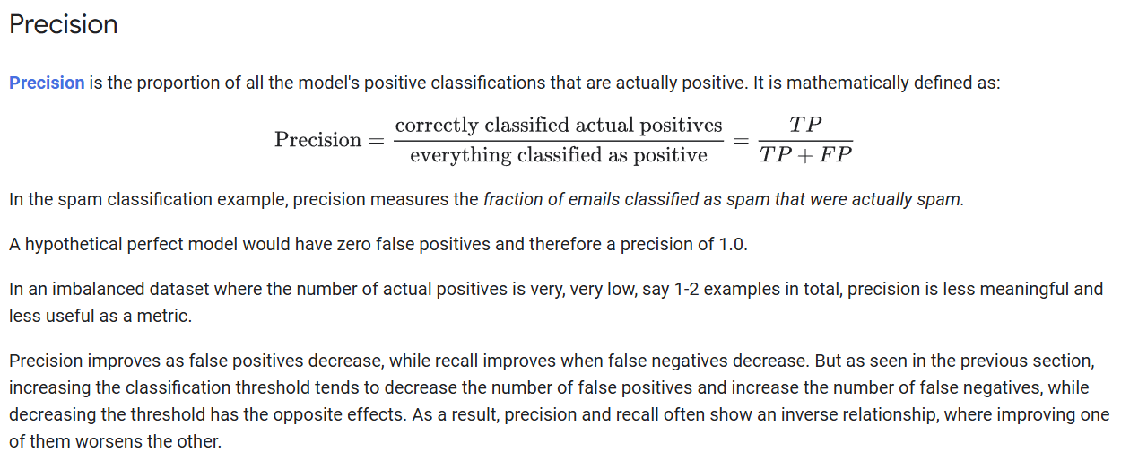

Slide 29
Accuracy: 0.85
Recall: 0.83
Precision: 0.85
Accuracy: 0.69
Recall: 0.63
Precision: 0.73
Accuracy: 0.53
Recall: 1.0
Precision: 0.11

Slide 30
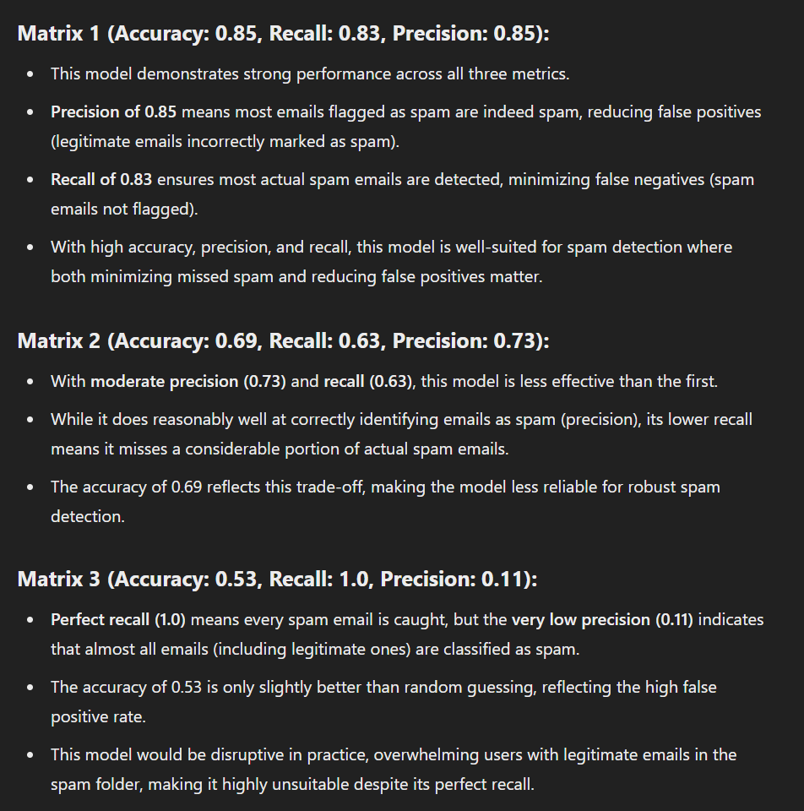

Slide 31
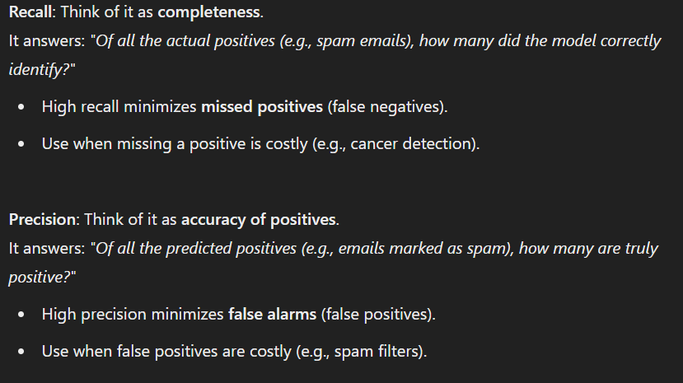

Slide 32
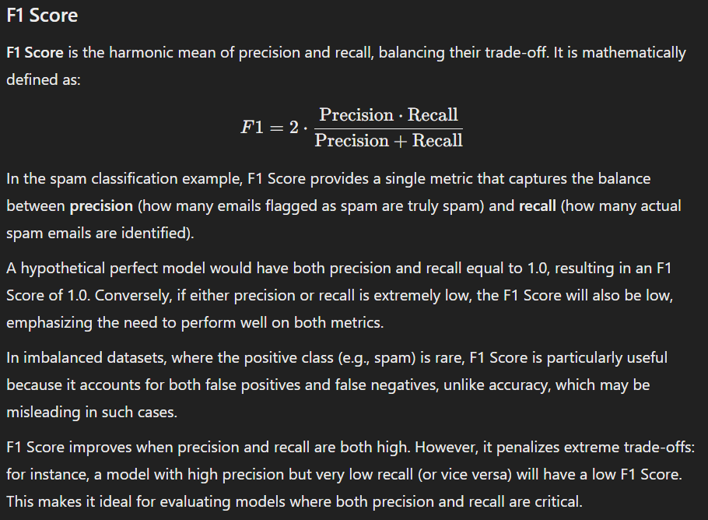

Slide 33
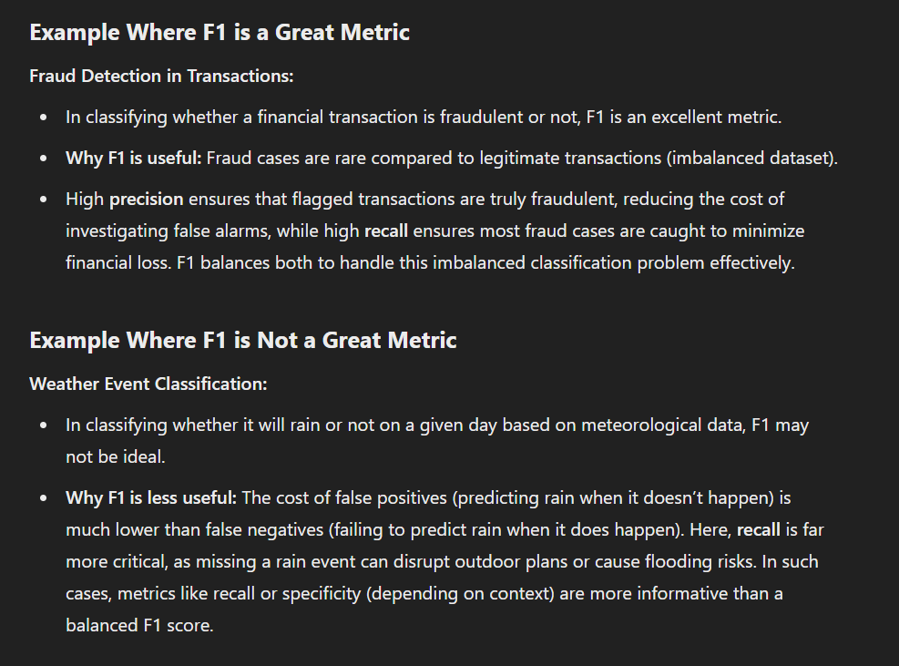

Slide 34
Accuracy: 0.85
Recall: 0.83
Precision: 0.85
F1: 0.84
Accuracy: 0.69
Recall: 0.63
Precision: 0.73
F1: 0.67
Accuracy: 0.53
Recall: 1.0
Precision: 0.11
F1: 0.20

Slide 35
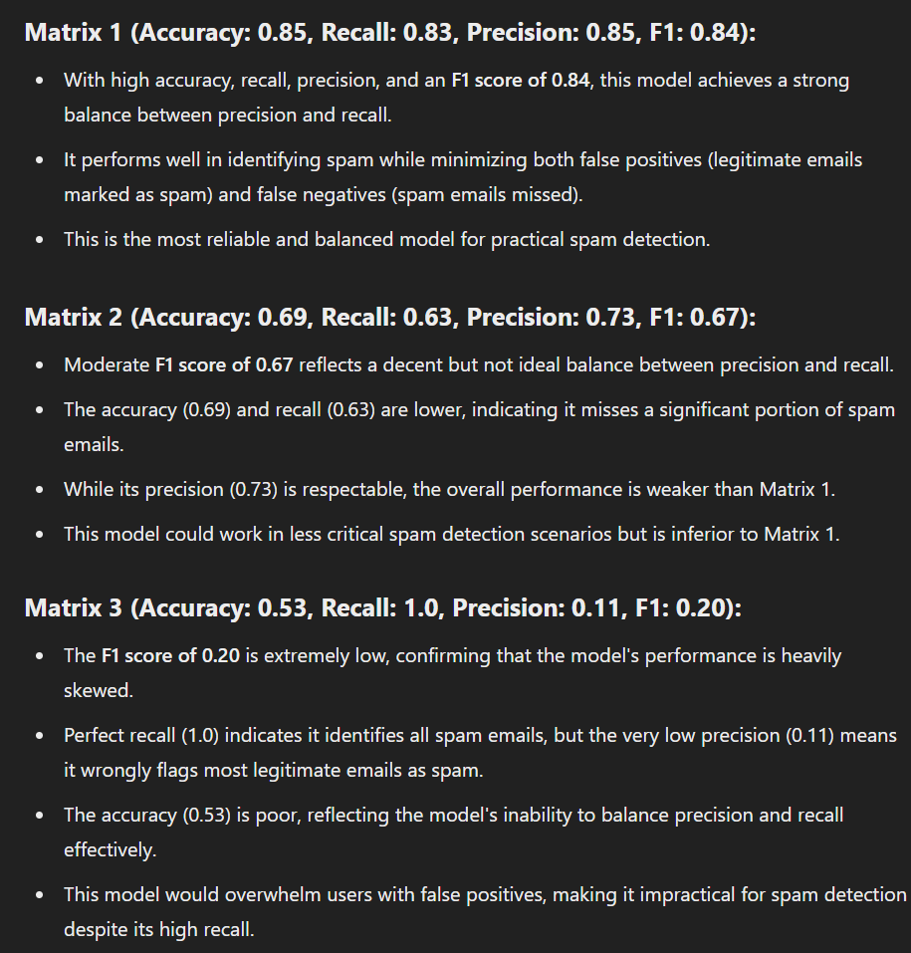

Slide 36
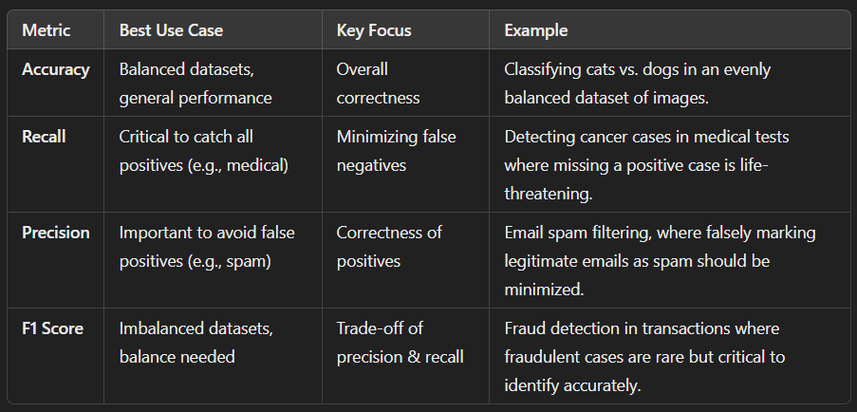

Slide 37
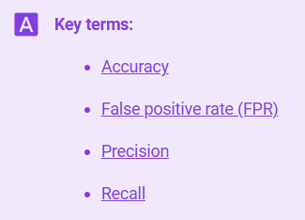
Notes:
https://developers.google.com/machine-learning/glossary

Slide 38
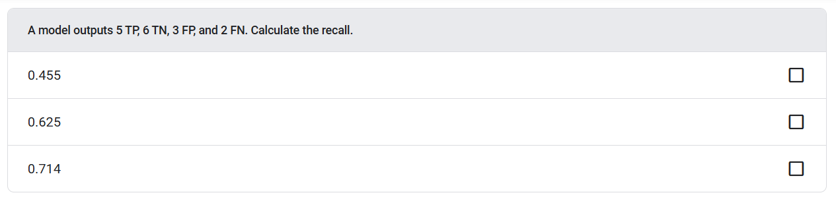

Slide 39
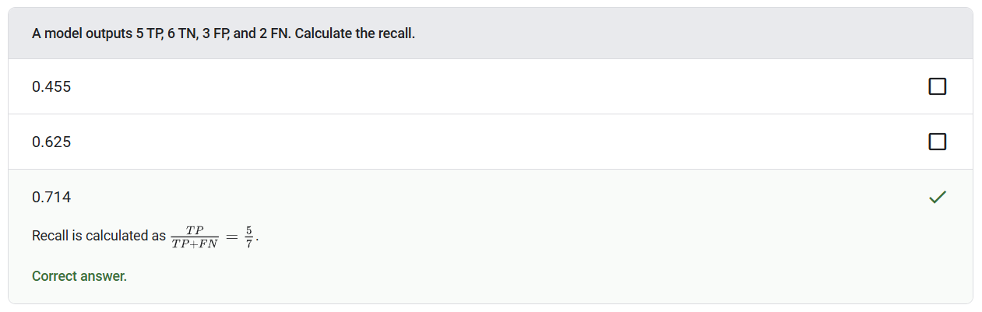

Slide 40
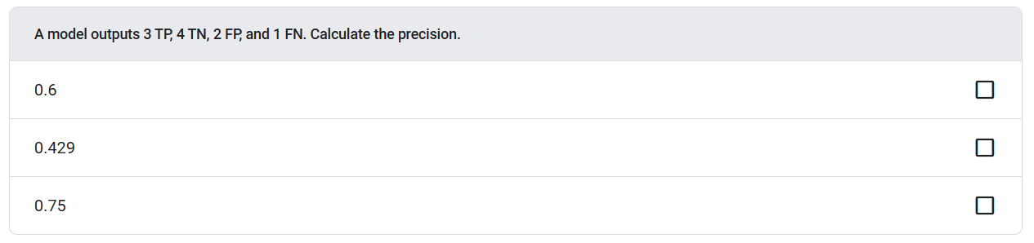

Slide 41
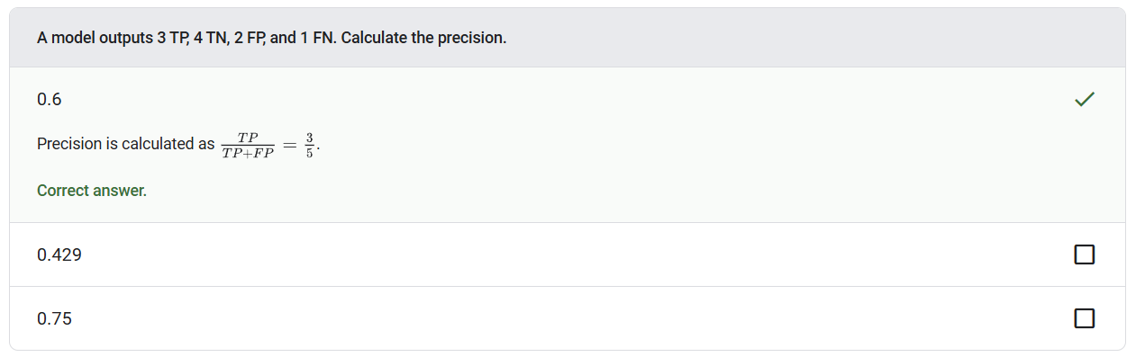

Slide 42
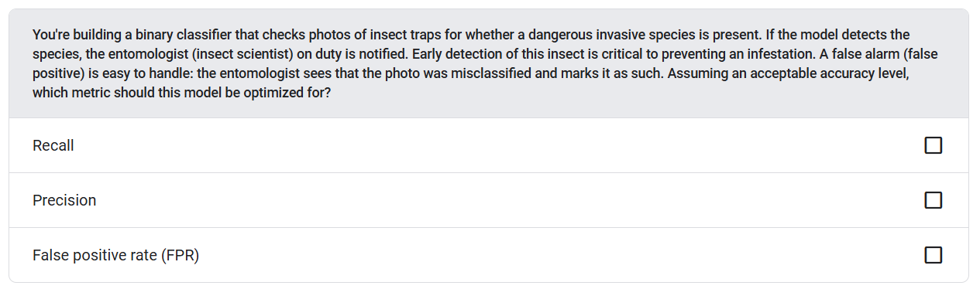

Slide 43
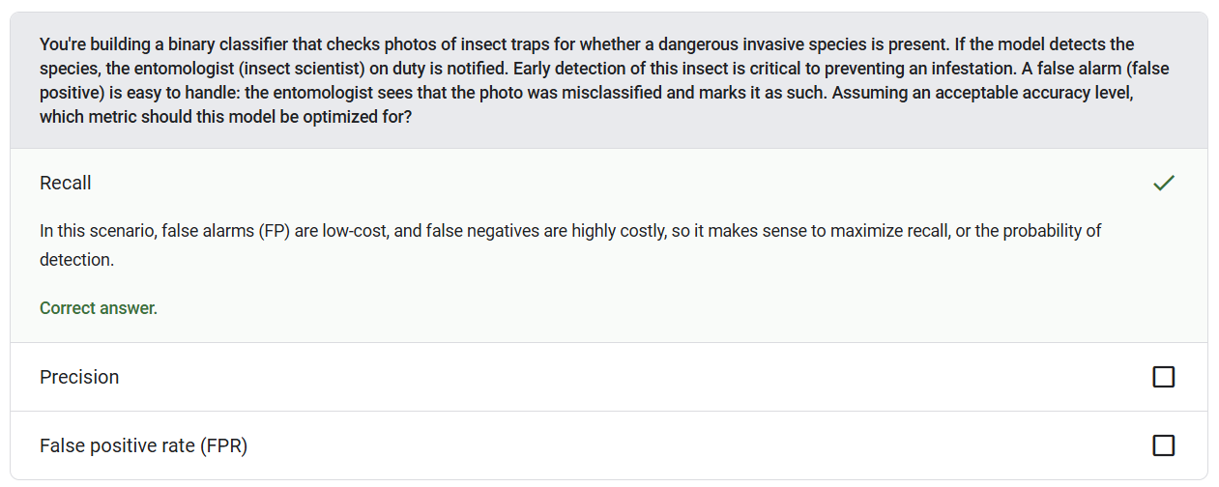

Slide 44


